Slide 1
COVID-19 Analysis:
Exploring International Trends in COVID-19 Cases and Deaths
Haley Miller, Maggie Samaan, Richard Hamilton, Aishwarya Karthik

Slide 2
Overview
Background
An epidemic refers to an unexpected increase in cases of disease in a specific area¹
A pandemic is an epidemic that has spanned across locations¹
COVID-19 is now the deadliest pandemic in the history of the United States, as of September 2021³
Scientists are now discussing COVID-19 as becoming endemic- a disease that continually circulates a population or area with occasional outbreaks⁵
Epidemic
Pandemic
Endemic

Slide 3
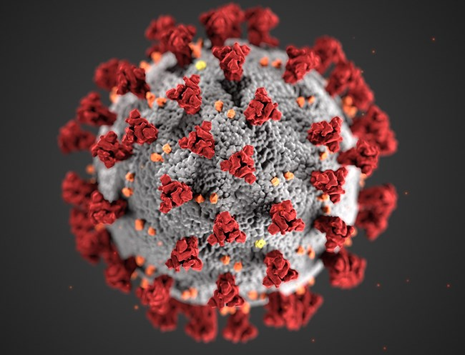
Purpose of COVID-19 Analysis
Create a functional prediction model relating to the healthcare/medical field
Several topics considered including cancer, malaria, and COVID-19
COVID-19 selected due to availability of current data
Analysis of COVID-19 to ultimately to predict the health outcomes in future populations
CDC/SCIENCE PHOTO LIBRARY

Slide 4
Data Source
Our World in Data (OWID)
Data
An organization that focuses on researching international crises including issues like climate change, war, and disease
Dataset compiled from multiple data sources including Johns Hopkins University, Oxford Government Response Tracker, UN, and World Bank
Along with information contained on the website, dataset and explanation of data easily accessible on OWID’s GitHub https://github.com/owid/covid-19-data
Several data fields within dataset continue to be updated daily (e.g. number of cases and deaths)
67 columns and 198,847 rows of data
Columns indicate international data including country, COVID-19 cases, COVID-19 deaths, vaccinations, population, and several other socioeconomic factors
Unique rows characterized by entries from a country on a certain date

Slide 5
Potential Outcomes of Analysis
Goals
Questions
Identify differences between the health outcomes of people from different countries
Predict new cases of COVID-19 in various countries
Determine the relationship between the spread of COVID-19 and health factors for global populations
Compare the accuracy of predicting new cases with a regression model and neural network
How can the number of daily new cases be predicted based on information such as cases, vaccinations, people vaccinated, and population density?
Can new cases be better predicted by a machine learning regression model or a neural network?
How can future health outcomes be predicted from this data?

Slide 6
Analysis
“As public health people, we’re often working in a little bit of the dark, trying to make our best estimates with really uncertain information”
-Dr. Bill Miller, The Ohio State University²

Slide 7
Analysis Roadmap
Exploratory Analysis
Running Machine Learning
Summarizing Analysis
Loading Data
Preprocessing Data
Creating Visualizations
Establishing Database
.
1
2
3
4
5
6
7

Slide 8
Data Exploration
Utilizing Python and Jupyter Notebook, the data was explored to determine the nature of each column, the number of values contained in each column, and the significance of each column
Due to the collection and variety of data, there were significant disparities in the data between both rows and columns
Challenge 1
Challenge 2
Challenge 3
Not all rows contained the same format of data
There were several null values within the dataset
Not all null values could be dropped as it would severely diminish necessary data points

Slide 9
Loading Data
AWS used to allow cohesive access of data and database to all group members
CSV file from 7/5/22 uploaded into S3 bucket to be accessed with PySpark
RDS instance created to connect to Postgres within local PgAdmin
Google Colab notebook created to start PySpark session and load data from CSV to a dataframe
An id_row was created to be the index for each row of data

Slide 10
Loading Data (cont.)
Data types were changed to match PySpark schema and schema in the database
Two dataframes were created; one to hold case specific data (number of cases, deaths, hospitalizations etc.) and one to hold demographic information (population, age, poverty, GDP)
Tables created in RDS instance to match data types and columns of the two separate dataframes
Data loaded from PySpark dataframes to Postgres

Slide 11
Establishing Database
The two tables (cases_data and demos_data) were joined together with a full outer join on the id_row column into a new table; combined_COVID_data
The data was filtered to only include valid countries within the location column and loaded into the table all_countries_data
All columns were maintained for further exploration for feature engineering
A connection was made from the database to the next phase of analysis-the machine learning component

Slide 12
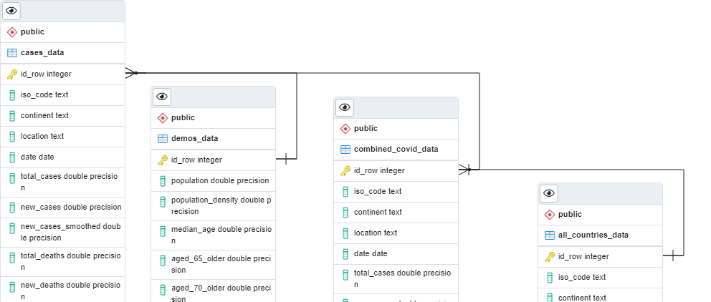
Establishing Database (cont.)
-ERD for tables created

Slide 13
Preprocessing Data
Dropping Data
COVID-19 dataset initially contained 198,846 rows of data organized in 67 columns between January 1st, 2020 and July 5th, 2022
All COVID-19 testing data was removed since testing policies, availability, interpretation, and reporting were sporadic and varied significantly among countries
Columns related to calculated excess_mortality were dropped as they are not relevant to the intended predictions
The columns related to Intensive Care Unit (ICU) and hospital admissions were removed due to containing a high number of null values
General columns with redundant information from other columns were dropped, leaving the dataframe with 43 columns

Slide 14
Preprocessing Data (cont.)
Addressing Missing Data
All null values from the total_cases column were dropped and the new_cases nulls were filled with zeros as the goal was to predict the number of daily new cases
By dropping the missed values from total cases, the missing values of new cases decreased significantly and the remaining missing values from new cases were filled with zeros
Death-related columns would only be features in the COVID-related deaths prediction model but not in the daily new cases prediction model so they were separated into a different dataframe
The column reproduction_rate: represents a real-time estimate of the effective reproduction rate (R) of COVID-19 and there was no discernable reason for the number of missing values (31,175)
The missing values were dropped instead of being replaced with zeros to avoid skewing results leaving the dataframe with a total of 190 countries

Slide 15
Preprocessing Data (cont.)
Vaccination Columns
Out of 148,217 records, there were only 44,719 records with reported daily total vaccinations numbers from all 190 locations
The 103,498 total_vaccinations and total_vaccinations_per_hundered nulls were filled with zeros because the absence of vaccines emphasized certain trends in the pandemic
The column containing the number of people fully vaccinated was selected since the completion of vaccination regimen indicated a superior level of immunity against the virus
The window of analysis was shortened to include all records from 1/1/2020 up until 3/29/2022 since the daily vaccination reporting was inconsistent in many countries after that time
Following cleaning of vaccination columns, a total of 34 columns were left for feature engineering

Slide 16
Preprocessing Data (cont.)
Feature Engineering
Date column was converted to datetime and the dates were filtered to only include data from 1/1/2020 until 3/28/2022
A new column was created to reflect the number of days into the COVID-19 pandemic for each record, which ultimately replaced the date column
Additional columns were created to represent the differences between daily total vaccinations and daily people total vaccinated
Columns were then normalized to per 100,000 people of each location's population
The cleaned dataset was split into two dataframes: one for cases prediction and another for deaths predictions

Slide 17
Machine Learning
Model Selection
Random Forest Regressors are a type of ensemble learning models that combines multiple smaller models into a more robust and accurate model
Random forest models use a number of weak learner algorithms (decision trees) and combine their output to make a final regression decision
Structurally speaking, random forest models are very similar to their neural network counterparts
Random forest models have been a staple in machine learning algorithms for many years due to their robustness and scalability
Both output and feature selection of random forest models are easy to interpret, and they can easily handle outliers and nonlinear data

Slide 18
Machine Learning (cont.)
Results
XXXXXXXXXXXXXXXXXXXXXXXXXXXXXXXXXXXXX
XXXXXXXXXXXXXXXXXXXXXXX
XXXXXXXXXXXXXXXXXXXXXXXXXXXXXXXXXXXXXX
XXXXXXXXXXXXXXXXXX

Slide 19

Creating Visualizations

Slide 20
Summarizing Analysis
XXXXXXXXXXXXXXXXXXXXXXXXXXX
XXXXXXXXXXXXXXXXXXXXX
XXXXXXXXXXXXXXXXXXXXXXX
XXXXXXXXXXXXXXXXXXXXXXXXXXXX
XXXXXXXXXXXXXXXXXXXX

Slide 21
Summarizing Analysis (cont.)
Limitations
Time and Resources
Unable to use models to predict deaths relating to COVID-19
Unable to predict the number of cases and deaths in future populations
XXXXXXXXXXXXXXXXXXXX
“All models are wrong, it’s striving to make them less wrong and useful in the moment”
-Mark Weir, The Ohio State University²

Slide 22
Technologies, Languages, and Tools Used
Software and Framework
Libraries and Packages
(3.7.13), Jupyter Notebook (6.4.11), Anaconda (4.13.0), PostgreSQL (11.15-R1), Tableau (2020.4), pgAdmin4 (6.7), Spark (3.2.1), Visual Studio Code (1.65.0)
Pandas (1.3.5), matplotlib (3.5.1), NumPy (1.21.5), PySpark, JAVA, PostgreSQL driver, MLlib, Scikit-learn (1.0.2), Scikit-learn (0.23.2) for Ensemble Learning, imbalanced-learn library (0.7.0) tensorflow (2.3.0), keras-applications (1.0.8), keras-preprocessing (1.1.2), psycopg2 (2.9.3)
Online Tools
AWS RDS, AWS S3, Google Colaboratory Notebooks, [COVID-19_Analysis GitHub Repository]

Slide 23
Questions?
max growth

Slide 24
References
Centers for Disease Control and Prevention. (2012, May 18). Principles of Epidemiology. Centers for Disease Control and Prevention. Retrieved July 24, 2022, from https://www.cdc.gov/csels/dsepd/ss1978/lesson1/section11.html
Koerth, M., Bronner, L., & Mithani, J. (2020, March 31). Why it's so freaking hard to make a good COVID-19 model . FiveThirtyEight. Retrieved July 24, 2022, from https://fivethirtyeight.com/features/why-its-so-freaking-hard-to-make-a-good-covid-19-model/
Lovelace, B. (2021, September 20). Covid is officially America's deadliest pandemic as U.S. fatalities surpass 1918 flu estimates. CNBC. Retrieved July 24, 2022, from https://www.cnbc.com/2021/09/20/covid-is-americas-deadliest-pandemic-as-us-fatalities-near-1918-flu-estimates.html
Ritchie, H., Mathieu, E., Rodés-Guirao, L., Appel, C., Giattino, C., Ortiz-Ospina, E., Hasell, J., Macdonald, B., Beltekian, D., & Roser, M. (2020, March 5). Coronavirus pandemic (COVID-19). Our World in Data. Retrieved July 24, 2022, from https://ourworldindata.org/coronavirus
Zarefsky Contributing News Writer, M. (2022, April 1). How we will know when covid-19 has become endemic. American Medical Association. Retrieved July 24, 2022, from https://www.ama-assn.org/delivering-care/public-health/how-we-will-know-when-covid-19-has-become-endemic

